Slide 1
Software Architect Design
Final Project
POS System
HIT Team

Slide 2




Contents
Project Summary
Project Plan
POS Architecture Driver
POS Architecture Design
Demo

Slide 3
Introduction to POS System
The project team will develop a sale system on websites with the purpose bring the convenience and helpful in the sale for Company A, a retail chain (hereinafter, the system). POS system will contain a number of functions that help manage product as well as sale process.
Administrator can do following function:
Add New User
Search/ View User List
View User Detail Information
Update User Information, Assign Authorize
Add New POST
Search/ View POST List
View POST Detail Information
Update POST Information
Staff can do following function:
Add New Product
Search/ View Product List

Slide 4
Contents
Project Summary
Project Plan
POS Architecture Driver
POS Architecture Design
Demo

Slide 5
Work Breakdown Structure

Slide 6
Schedule

Slide 7
ACDM Stages

Slide 8
Contents
Project Summary
Project Plan
POS Architecture Driver
POS Architecture Design
Demo

Slide 9
Entities
Administrator
Head Office Manager
Staff
Cashier
Member

Slide 10
Entity Scenarios

Slide 11
Entity Scenarios

Slide 12
Entity Scenarios

Slide 13
Entity Scenarios

Slide 14
Entity Scenarios

Slide 15
Use-case

Slide 16
Business Constrains
Consideration | ID | Business Constraints.
Organizational restrictions and demands. | BC01 | One team with 6 members
Market restrictions and demands | BC02 | Produced only for ABC Company

Slide 17
Technical Constrains
Consideration. | ID | Technical Constraints
Commercial hardware or software products. | TC01 | Bar code readers Keyboard Computer SQL Server Database
Tools and methods. | TC02 | Visual Studio 2010, SQL Server Management Studio 2008. .Net Framework ASP.Net MVC 3.0
Protocols, interfaces, standards. | TC03 | TCP/IP protocol
Computer operating system(s) | TC04 | Window 7
Computer languages(s) | TC05 | C#

Slide 18
Quality Attributes
Performance
Security
Availability

Slide 19
Quality Attribute Scenarios
Title of scenario: Sale product when database at Head Office crash |  | ID: QAS1 | Version: 1.1
 |  |  | Last Changed: 04/07/2012
Quality attribute: Availability |  | Characterization ID: QA2
Describe stakeholder role proposing the description: Cashier
Source(s) of the stimulus | End user
Stimulus | Send a request to get product information
Relevant environmental conditions | When the database in the Head Office has been crash.
Architectural elements | System and the information in the system
System response | The system get information in backup database and response to client
Response measure(s) | Response within 5 seconds
Associated risks

Slide 20
Quality Attribute Scenarios
Title of scenario: Bill |  | ID: QAS2 | Version: 1.1
 |  |  | Last Changed: 04/07/2012
Quality attribute: Performance |  | Characterization ID: QA1
Describe stakeholder role proposing the description: Cashier
Source(s) of the stimulus | End user
Stimulus | Send a request to save bill to the system
Relevant environmental conditions | When the system operation normally.
Architectural elements | System and the information in the system
System response | The system save information in primary database and response to client save bill success
Response measure(s) | Response within 5 seconds
Associated risks

Slide 21
Quality Attribute Scenarios
Title of scenario: Displays statistical reports |  | ID: QAS3 | Version: 1.1
 |  |  | Last Changed: 04/07/2012
Quality attribute: Performance |  | Characterization ID: QA2
Describe stakeholder role proposing the description: Manager
Source(s) of the stimulus | End user
Stimulus | Send a request to Statistics
Relevant environmental conditions | When the system operation normally.
Architectural elements | System and the information in the system
System response | The system get information in primary database and response to client
Response measure(s) | Response within 5 seconds
Associated risks

Slide 22
Quality Attribute Scenarios
Title of scenario: Scan customer |  | ID: QAS4 | Version: 1.1
 |  |  | Last Changed: 04/07/2012
Quality attribute: Performance |  | Characterization ID: QA2
Describe stakeholder role proposing the description: Cashier
Source(s) of the stimulus | End user
Stimulus | Send a request to get customer information
Relevant environmental conditions | When the system operation normally.
Architectural elements | System and the information in the system
System response | The system get information in primary database and response to client
Response measure(s) | Response within 3 seconds
Associated risks

Slide 23
Quality Attribute Scenarios
Title of scenario: Block unauthorized access |  | ID: QAS5 | Version: 1.1
 |  |  | Last Changed: 04/07/2012
Quality attribute: Security |  | Characterization ID: QA1
Describe stakeholder role proposing the description: Cashier, manager, staff
Source(s) of the stimulus | unknown identity
Stimulus | Try to access the system illegitimacy
Relevant environmental conditions | When the system operation normally.
Architectural elements | System and the information in the system
System response | The system block this request
Response measure(s)
Associated risks

Slide 24
Quality Attribute Scenarios
Title of scenario: Authority |  | ID: QAS6 | Version: 1.1
 |  |  | Last Changed: 04/07/2012
Quality attribute: Security |  | Characterization ID: QA1
Describe stakeholder role proposing the description: Cashier, manager, staff
Source(s) of the stimulus | End user
Stimulus | Login in to the system
Relevant environmental conditions | When the system operation normally.
Architectural elements | System and the information in the system
System response | The system authorize for users by account type
Response measure(s)
Associated risks

Slide 25
Contents
Project Summary
Project Plan
POS Architecture Driver
POS Architecture Design
Demo

Slide 26
Context Diagram

Slide 27
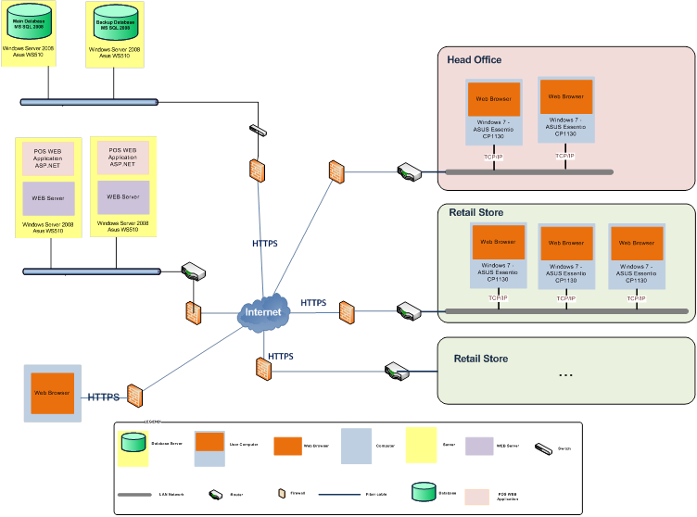
Allocation View

Slide 28
Data Model

Slide 29
Module View

Slide 30
C&C View

Slide 31
Mapping View

Slide 32
Contents
Project Summary
Project Plan
POS Architecture Driver
POS Architecture Design
Demo

Slide 33
Thanks
for your listening!

